Slide 1
Finding best locations for placing ATM
Final capstone project

Slide 2
introduction
FINDING BEST LOCATIONS IN A CITY IS A BIG CHALLENGE FOR BANKS
CONSUMER SOCIAL BEHAVIOUR BASED ON GEO-SPATIAL DATA BE USED IN DECISION MAKING
CLUSTERING CAN BE DONE ON THE GEO SPATIAL DATA FOR FINDING THE CLUSTERS WITH BEST LOCATIONS
THIS WILL HELP IN REDUCING THE OPERATIONAL COST FOR BANKS WITH BETTER CUSTOMER SERVICE AND PRESENCE
HAVE SELECTED THE TORONTO CITY AS PILOT FOR DOING THE DATA ANALYSIS

Slide 3
DATA SOURCES
WIKI PAGE FOR GETTING THE NEIGHBOURHOODS/POSTAL CODE IN TORONTO
CANADA STATISTICS TO GET THE POPULATION DENSITY IN NEIGHBOURHOOD
FOUR SQUARE API TO GET THE VENUE DETAILS IN EACH NEIGHBOURHOOD IN CANADA
GEOSPATIAL DATA

Slide 4
METHODOLOGY
NEIGHBOURHOODS/POSTAL CODES ARE TAKEN FROM THE WIKI FOR TORONTO
CORRESPONDING POPULATION DATA IS TAKEN FROM CANADA STATISTICS
GEO LOCATIONS FOR EACH NEIGHBOURHOOD IS ADDED TO THE DATA
PRIMARY CATEGORIES FOR FOUR SQUARE CLASSIFICATION ARE IDENTIFIED
COUNT OF VENUES FOR EACH NEIGHBOURHOOD ACROSS CATEGORIES IS CALCULATED
9 DIMESNSIONS OF DATA ARE IDENTIFEID FOR CLUSTERING

Slide 5
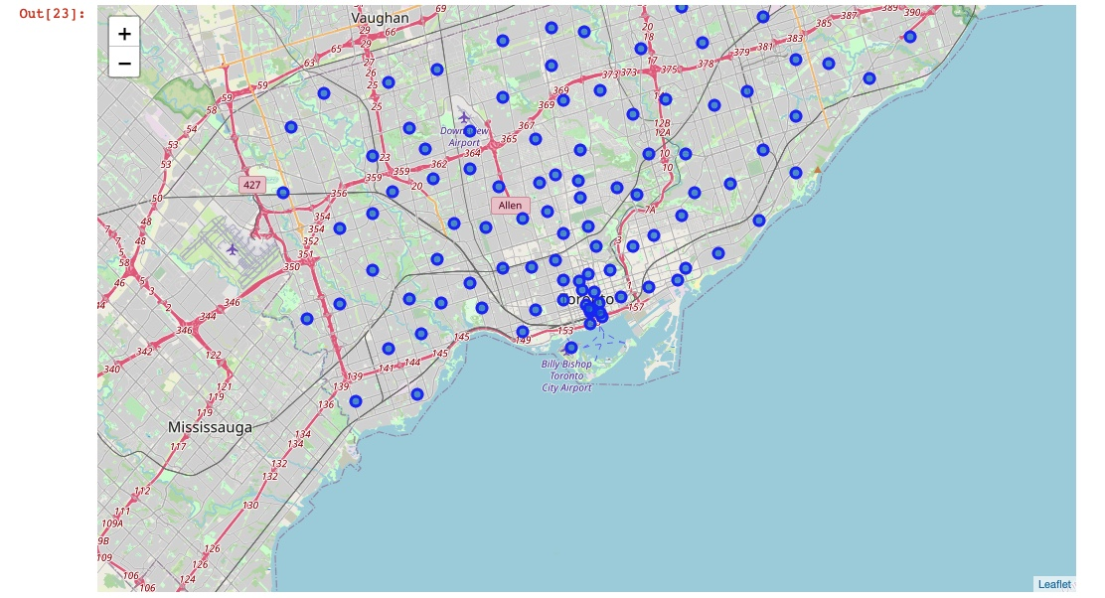

Slide 6
RESULTS
ENTIRE TORONTO CITY IS DIVIDED INTO FOUR CLSUETRS BY K-MEANS ALGORTHM
CLUSTER 1 – HIGH POPULATION/HIGH VENUES
CLUSTER 2 – HIGH POPULATION/LOW VENUES
CLSUTER 3 – LOW POPULATION/HIGH VENUES
CLUSTER 4 – LOW POPULATION/LOW VENUES

Slide 7
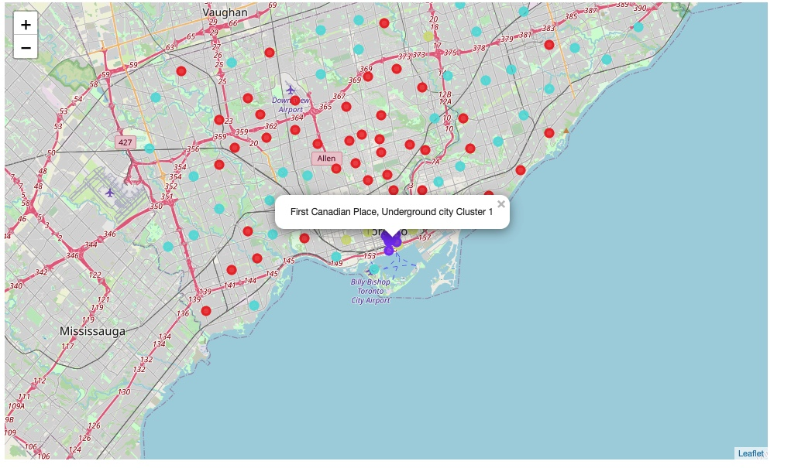

Slide 8
CONSLUSION
PRIORITY ORDER IS PROVIDED ACROSS CLUSTERS FOR SETTING UP THE ATM’S
44 NEIGHBOURHOODS ARE IDENTIFIED AS BEST LOCATIONS FOR PLACING THE ATMS

